Slide 1
Privacy Preserving Collaborative IDS for Internet of vehicle networks

Slide 2
Content:
1. Architecture Pipeline

Slide 3
Overall Architecture(phases):
1. Architecture Pipeline

Slide 4
High-Level Architecture (The Pipeline)
Phase 1:
Goal: Establish a cryptographically authenticated state before federated training begins.
Step 1: Load & Unify Datasets
Step 2: Centralized Stratified Split (70% / 15% / 15%)
Step 3: Dirichlet Non-IID Partitioning
Step 4: Global Model Initialization
Step 5: Secure Channel Setup
Step 6: Genetic Algorithm (GA) Configuration
Step 7: Encrypted Broadcast & Integrity Verification

Slide 5
Data Unification & Real-World Simulation
Datasets Unified: CAN-VTC, Car-Hacking, CICIDS 2017, and VeReMi.
Stratified Splitting: * 70% Train | 15% Validation | 15% Test.
  Statistics (z-score) fitted only on the training split to prevent data leakage.
Simulating the Fleet (Non-IID Distribution):
  Used Dirichlet allocation (α=0.3).
  Distributes training data unevenly across simulated clients (50, 100, or 200).
  Creates realistic "class skew" so no two vehicles see the exact same distribution of threats.

Slide 6

Unified Dataset Adapter Interface:
Shows how raw data sources are read and converted into sliding windows of message streams.
For example, in
can_vtc_dataset.py
(and similarly for other logs), raw logs are parsed into numpy arrays, windowed, and labeled dynamically.

Slide 7


Unifying Heterogeneous Data to a Timeless 46-D Feature Vector
Shows the mathematical/structural representation of the timeless CAN descriptors (from can_features.py) that enables dataset-agnostic training.

Slide 8

Normalization & Preprocessing
Shows how the splits are scaled identically to avoid data leakage (from build_dataset.py).

Slide 9

Dirichlet:
It partitions a centralized dataset across N client vehicles such that each client receives a highly skewed, non-IID (non-independently and identically distributed) subset of data. This simulates realistic Internet of Vehicles (IoV) environments where different vehicles encounter different ratios of normal traffic and specific cyber-attacks.

Slide 10
Core Model & Cryptographic Security
The Model:
KANConvNet: Global model initialized on the server with 145,668 parameters.
Supports loading pre-trained weights with strict=False to adapt to different dataset class counts.
The Secure Channel:
Identity: Long-term Ed25519 keys for mutual authentication.
Key Exchange: ECDH-P256 generates fresh ephemeral keys.
Encryption: FHE(functions left empty so FHE can be inserted into it)
Key-Derivation: HKDF-SHA256 (HMAC-based Extract-and-Expand Key Derivation Function)

Slide 11
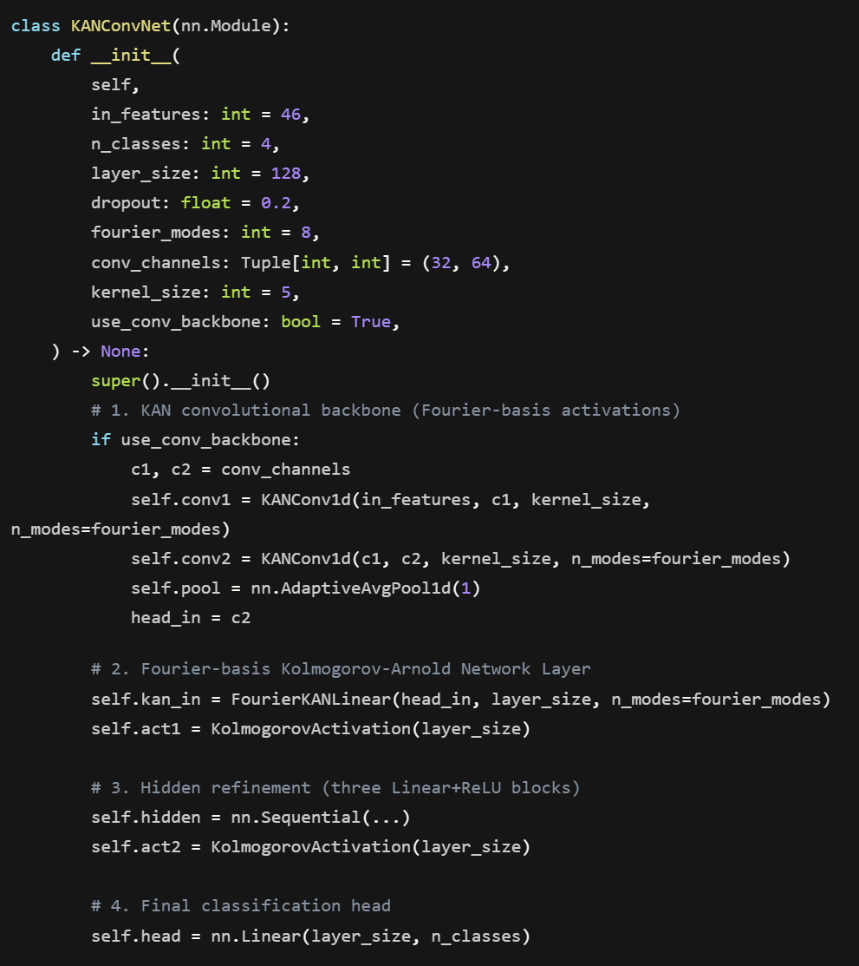
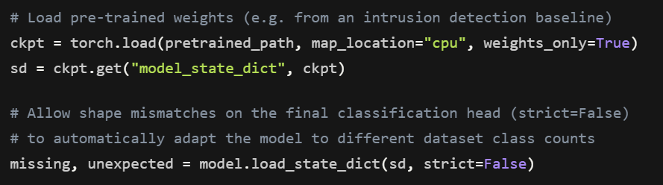
KANConvNet & Adapting Weights
Global model layout, which features a KAN convolutional backbone followed by a Fourier-basis KAN linear layer, hidden refinement blocks, and a final classification head:
Loading Weights with strict=False:
The server handles bootstrap weight adaptation to match the exact class structure of the target dataset:

Slide 12
ConvAutoEncoder parameters:
Total Parameters: 45,998
Encoder:
  Weights – 22,848
  Bias – 160
Decoder:
  Weights – 22,848
  Bias - 142

Slide 13
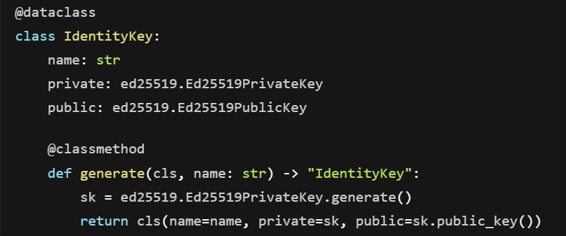
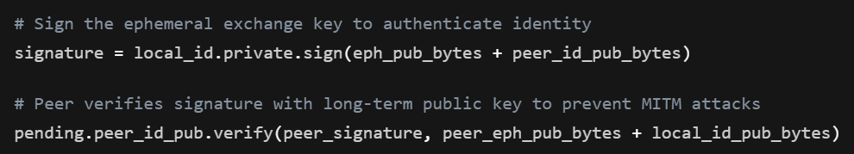
The Secure Channel Cryptography
Identity: Long-term Ed25519 Mutual Authentication
Each entity holds a long-term asymmetric Ed25519 keypair for identity authentication and signing during handshakes
During the handshake, a party signs its ephemeral key plus the peer's public identity:

Slide 14
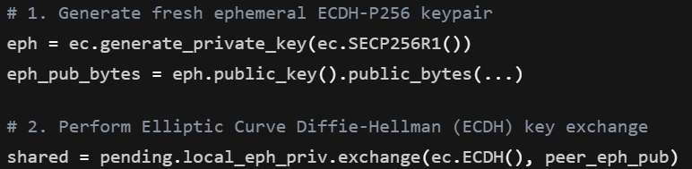
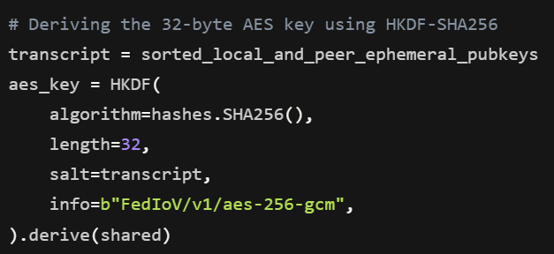
Key Exchange: Ephemeral ECDH-P256
Fresh, short-lived (ephemeral) elliptic curve keypairs are generated and swapped to derive a shared secret:
Key-Derivation: HKDF-SHA256 (HMAC-based Extract-and-Expand)
The shared secret is combined with the handshake transcript to safely derive a symmetric key:
Encryption: FHE adapter setup done so FHE part can be inserted here.

Slide 15
Optimization Setup (Genetic Algorithm)
Purpose: Prepares the system to automatically tune itself for different vehicular constraints.
Search Space Defined: Includes variables like batch size, epochs, momentum, L2 regularization, dropout, and optimizer type.
Combinatorial Space: 75,000 possible configurations.
Initial Population: Sampled uniformly with a size of 50.
Evolution Parameters: Locked to 20 generations with elitism set to 2.

Slide 16
Integrity Verification & Phase Boundaries
Broadcast Verification (Step 7):
Server serializes and encrypts the global model state for each client.
Clients decrypt and reconstruct the model locally.
Integrity Check: The system compares the SHA-256 digest of the server’s
model against every client's reconstructed model to prove bit-perfect fidelity.
Excluded from Phase 1 by Design:
CarNet dataset omitted per project requirements.
Deferred to Phase 2: Local training rounds, TOPSIS reduction, Multi-Krum aggregation,
GA fitness evaluation, and Differential Privacy noise.

Slide 17
Proof of Work & Smoke Test Results
System Sanity Check:
Execution Time: Completed in ~4.51 seconds for 50 clients.
Cryptographic Verification: 50/50 clients verified successfully.
1-Epoch Baseline Performance:
CAN-VTC: 99.89% Accuracy (Model learns instantly).
Car-Hacking: 94.96% Accuracy (Solid multi-class performance).
CICIDS-2017: 94.33% Accuracy (High detection on ~400k rows, minimal false positives).
VeReMi: 73.81% Accuracy (Reflects expected class imbalance; requires Phase 2
extended training to catch edge-case attacks).

